Slide 1
Music
He Still Does Miracles (Hawk Nelson)
Cornerstone (Hillsong)
1

Slide 2
Grace and Truth
Week 1
The Word Became Flesh

Slide 3
3

Slide 4
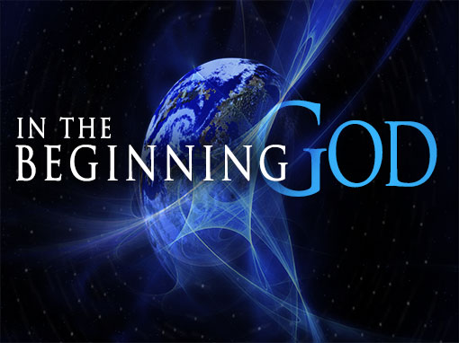
4

Slide 5
5

Slide 6
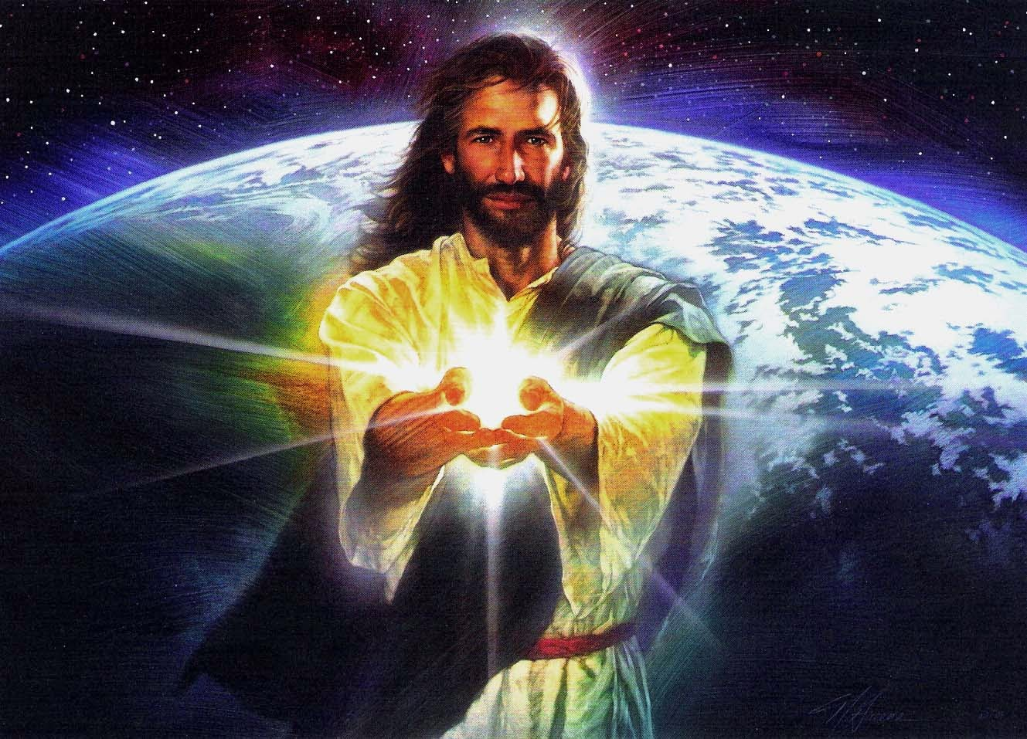
6

Slide 7
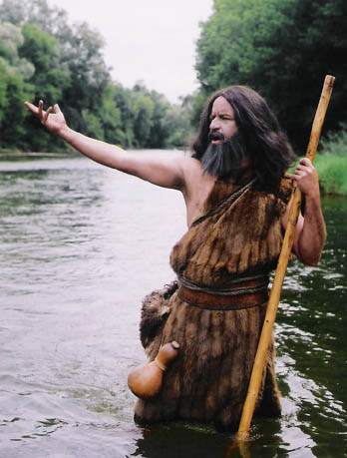
7

Slide 8
10

Slide 9
8

Slide 10
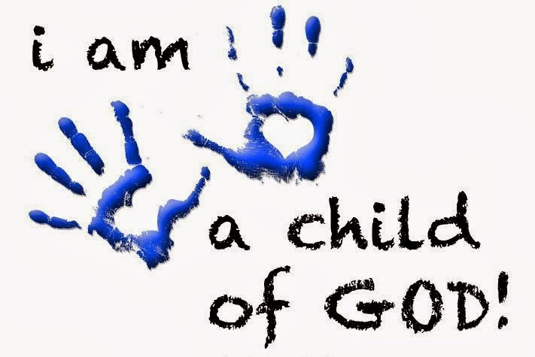
9

Slide 11
Grace and Truth
Week 2
Glory and Judgment

Slide 12
1 On the third day there was a wedding in Cana of Galilee, and the mother of Jesus was there. 2 Jesus and his disciples had also been invited to the wedding. 3 When the wine gave out, the mother of Jesus said to him, “They have no wine.” 4 And Jesus said to her, “Woman, what concern is that to you and to me? My hour has not yet come.” 5 His mother said to the servants, “Do whatever he tells you.” 6 Now standing there were six stone water jars for the Jewish rites of purification, each holding twenty or thirty gallons. 7 Jesus said to them, “Fill the jars with water.” And they filled them up to the brim. 8 He said to them, “Now draw some out, and take it to the chief steward.” So they took it. (John 2:1-7)
12

Slide 13
9 When the steward tasted the water that had become wine, and did not know where it came from (though the servants who had drawn the water knew), the steward called the bridegroom 10 and said to him, “Everyone serves the good wine first, and then the inferior wine after the guests have become drunk. But you have kept the good wine until now.” 11 Jesus did this, the first of his signs, in Cana of Galilee, and revealed his glory; and his disciples believed in him. 12 After this he went down to Capernaum with his mother, his brothers, and his disciples; and they remained there a few days. (John 2:9-12)
13

Slide 14
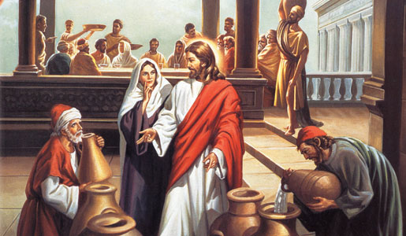
14

Slide 15
Stigma of Running Out of Wine
This depletion was a significant breach of courtesy in the Mediterranean world.
In Jewish culture, it was customary to have food left over at weddings—there shouldn’t be even a hint of running out of food.
Hospitality was a core value of the society and running out of wine would have placed a lasting social stigma on the groom’s family.
It may even have been viewed as a bad omen for the marriage.
15

Slide 16
16

Slide 17
Miracles as Signs
Signs help us understand who Jesus is and how we should respond to Him.
In John’s Gospel, Jesus performed seven signs leading up to the resurrection that proved He is Lord.
The first sign was this miracle at the wedding in Cana.
Performing His first sign at the wedding would eventually lead Jesus to the cross.
17

Slide 18
Significance of the Miracle
The fact that these jars were used to hold water for Jewish purification rites highlights the symbolism of this miracle.
Through Jesus’ life, death, and resurrection, Jesus eliminated the need for sacrifice and cleansing.
Our purity no longer comes from the ritual washing of our hands but the washing of our hearts with his Spirit.
Jesus was replacing the emptiness of Jewish ritual with something better: the abundant life of the Spirit.
Jesus’ disciples saw this revelation of Jesus’ glory and believed.
18

Slide 19
13 The Passover of the Jews was near, and Jesus went up to Jerusalem. 14 In the temple he found people selling cattle, sheep, and doves, and the money changers seated at their tables. 15 Making a whip of cords, he drove all of them out of the temple, both the sheep and the cattle. He also poured out the coins of the money changers and overturned their tables. 16 He told those who were selling the doves, “Take these things out of here! Stop making my Father’s house a marketplace!” (John 2:13-16)
19

Slide 20
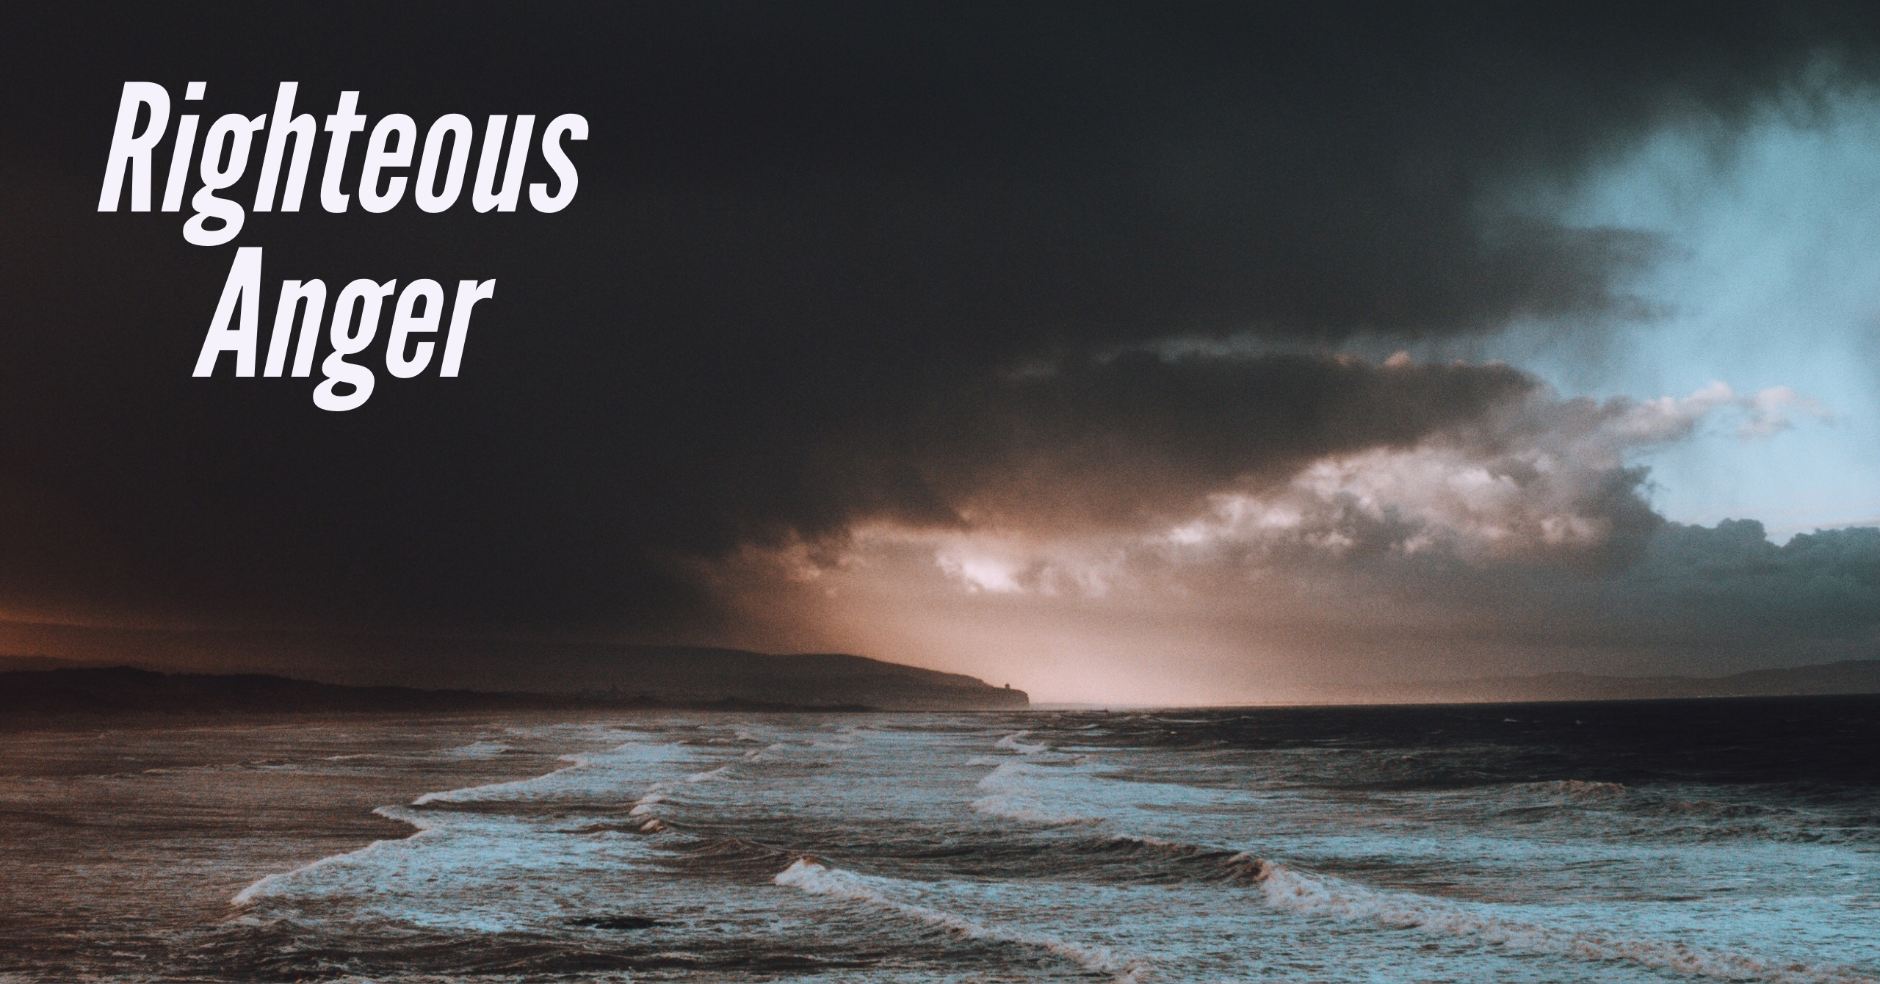
20

Slide 21
Righteous Anger
When Jesus arrived at the temple, He found people in the courts engaged in commerce.
By turning that area into a marketplace, the tradesmen had taken over the only place where Gentiles were allowed to worship.
Jesus responded with righteous anger.
21

Slide 22
17 His disciples remembered that it was written, “Zeal for your house will consume me.” 18 The Jews then said to him, “What sign can you show us for doing this?” 19 Jesus answered them, “Destroy this temple, and in three days I will raise it up.” 20 The Jews then said, “This temple has been under construction for forty- six years, and will you raise it up in three days?” 21 But he was speaking of the temple of his body. 22 After he was raised from the dead, his disciples remembered that he had said this; and they believed the scripture and the word that Jesus had spoken. (John 2:17-22)
22

Slide 23
23

Slide 24
Jesus as the New Temple
Those watching demanded to know what sign Jesus could give them to prove His authority to act this way.
Jesus pointed to the future sign of His resurrection: “Destroy this temple, and in three days I will raise it up”.
The witnesses didn’t understand what Jesus was saying and thought He was talking about the man-made temple building.
Destroying the temple and restoring it in three days would have seemed like an impossible task, but Jesus wasn’t talking about the actual temple building - Jesus was talking about Himself.
24

Slide 25
Jesus as the New Temple
The temple was the place where God had promised to live in the midst of His people.
Jesus was now replacing the temple with Himself.
Jesus knew the day was coming when His people’s worship would not be limited to one geographic place.
Instead, He would be with His people wherever they are through the presence of the Holy Spirit.
Jesus would build a new temple for Himself—a temple not built out of bricks and stones but from the hearts of those who follow Him as Lord (Ephesians 2:19–22).
25

Slide 26
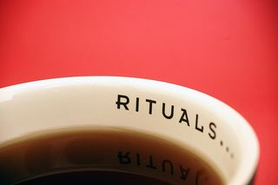
26

Slide 27
Rituals
Jesus Christ is the center of our faith.
The routines and rituals of our worship are a way to honor Him, but they do not make us holy.
We should not mistake symbols for the reality or use them as obstacles to bar people from entering our Father’s presence.
Christ alone cleanses us from our sin and purifies us through His Spirit.
Our sanctuaries are places for us to gather, but they are not the reason we worship; Jesus is.
27

Slide 28
Grace and Truth
Week 3
The Source of Eternal Life

Slide 29
Verses
19 So then you are no longer strangers and aliens, but you are fellow citizens with the saints and members of the household of God, 20 built on the foundation of the apostles and prophets, Christ Jesus himself being the cornerstone, 21 in whom the whole structure, being joined together, grows into a holy temple in the Lord. 22 In him you also are being built together into a dwelling place for God by the Spirit. (Ephesians 2:19-22)

Slide 30
The Seven Signs of John’s Gospel
Changing water into wine (2:1–11)
Healing an official’s son (4:43–54)
Healing the disabled man at the pool of Bethsaida (5:1–15)
Feeding the 5,000 (6:1–14)
Walking on water (6:16–21)
Healing a man who was born blind (9:1–12)
Raising Lazarus from the dead (11:1–44)

