Slide 1
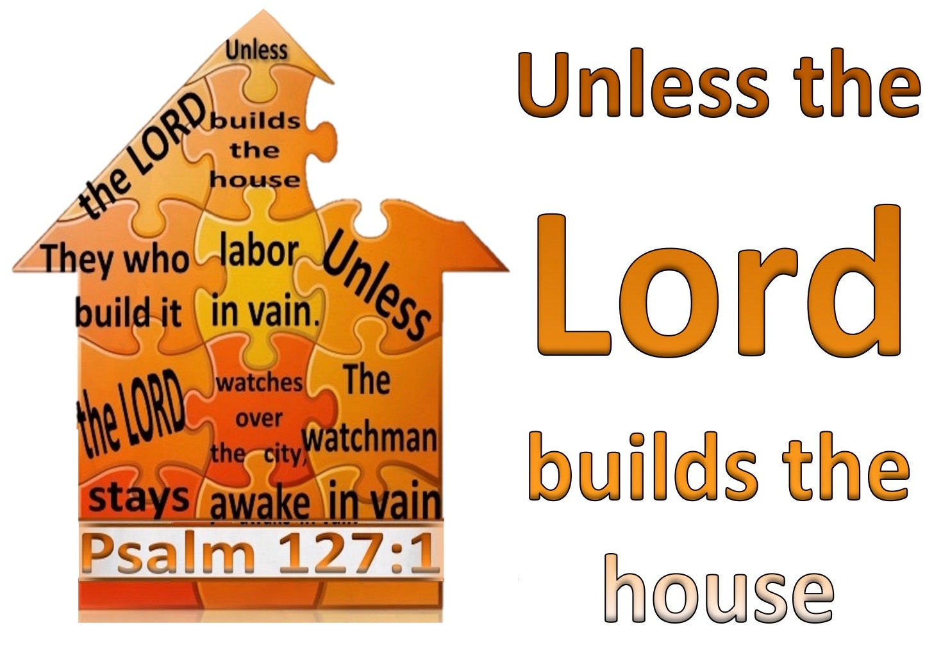

Slide 2
Psalm 127 (ESV)
Unless the Lord builds the house, those who build it labor in vain. Unless the Lord watches over the city, the watchman stays awake in vain. 2 It is in vain that you rise up early and go late to rest, eating the bread of anxious toil; for he gives to his beloved sleep. 3 Behold, children are a heritage from the Lord, the fruit of the womb a reward. 4 Like arrows in the hand of a warrior are the children of one's youth. 5 Blessed is the man who fills his quiver with them! He shall not be put to shame when he speaks with his enemies in the gate.

Slide 3
The Point & Big Idea
Unless the Lord builds the house, those who build it labor in vain. Unless the Lord watches over the city, the watchman stays awake in vain.” (Psalm 127:1 ESV)
As for me and my house, we will serve the Lord.

Slide 4


Slide 5
God is the Master Builder
Church – Built on the Rock (Jesus)
Families
Man’s efforts are never enough
Our work
  Be salt & life
  Love neighbor
Culture wars
Live God’s way not everyone else’s (wrong) – Tony Evans

Slide 6


Slide 7
Life Under the Sun
“I got this”
  Power
  Wisdom
  Fame
  Happiness
“Merry go round of normalcy”
Solomon – Vanity of vanities

Slide 8


Slide 9
Family
Marriage
Parents
  Warriors (not alone)
  Satan wants our children
    Heart
    Soul
    Mind
    Strength

Slide 10
Family
Children – Arrows (Aim, Tension & Send)
  Rules
  Relationships
Priorities
  Discipline – Social media
  Church - Extracurricular
  Eternity - College

Slide 11

Laborers

Slide 12
Laborers
Dad
  Provide & protect
  Love wife
  Lead repenter
  Pray & read bible together
  Make memories
  Delight in children
Mom
  “Don’t drip”
  Coach/Disciple
  Demonstrate God’s love

Slide 13
Question
How are you doing in building God’s house?

