Slide 1
Music
Born Again (Newsboys)
Grace, Love and Mercy (3rd Row Boys)
1

Slide 2
Grace and Truth
Week 2
Glory and Judgment
2

Slide 3
3

Slide 4
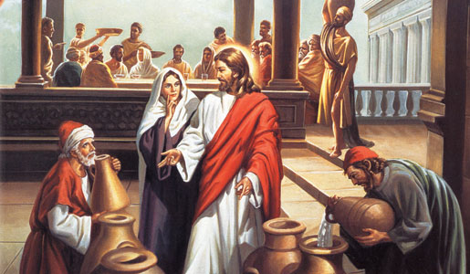
4

Slide 5
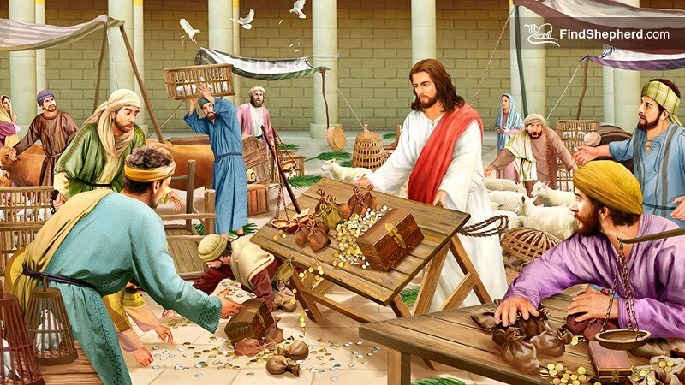
5

Slide 6
6

Slide 7
7

Slide 8
Grace and Truth
Week 3
The Source of Eternal Life
8

Slide 9
1 Now there was a Pharisee named Nicodemus, a leader of the Jews. 2 He came to Jesus by night and said to him, “Rabbi, we know that you are a teacher who has come from God; for no one can do these signs that you do apart from the presence of God.” (John 3:1-2)
9

Slide 10
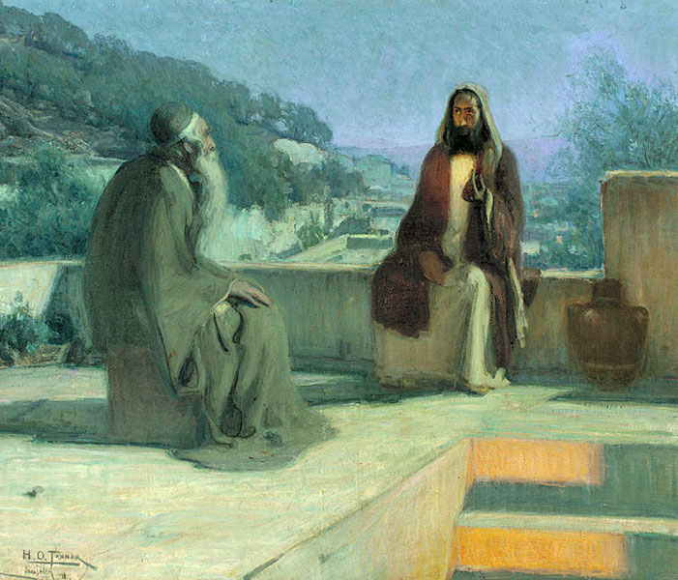
10

Slide 11
Pharisees
Nicodemus was a Pharisee and a leader of the Jews.
The Pharisees were a group of Jewish religious leaders who emphasized preserving the traditions of the faith.
The people followed them and believed their interpretations of Scripture were generally accurate.
The Pharisees were also antagonistic to Jesus.
11

Slide 12
Sanhedrin
Nicodemus was also a member of the Jewish ruling council.
Composed both of Pharisees and Sadducees, the Sanhedrin was the highest-ranking national body over Jewish affairs.
The Sanhedrin had some authority over internal Jewish matters.
Their conspiracy against Jesus led to His arrest and crucifixion.
As a Pharisee and a member of the Sanhedrin, Nicodemus was a person of influence.
This may be why he came to see Jesus at night.
12

Slide 13
Nicodemus’ Motivation
Usually only a man with formal religious training would be called a rabbi or teacher, so Nicodemus’ greeting to Jesus showed Him honor.
Nicodemus also recognized that the miracles Jesus did were a sign of God’s presence with Him.
He wanted to know more.
Jesus was about to confound all his expectations.
13

Slide 14
3 Jesus answered him, “Very truly, I tell you, no one can see the kingdom of God without being born from above.” 4 Nicodemus said to him, “How can anyone be born after having grown old? Can one enter a second time into the mother’s womb and be born?” 5 Jesus answered, “Very truly, I tell you, no one can enter the kingdom of God without being born of water and Spirit. 6 What is born of the flesh is flesh, and what is born of the Spirit is spirit. 7 Do not be astonished that I said to you, ‘You must be born from above.’ 8 The wind blows where it chooses, and you hear the sound of it, but you do not know where it comes from or where it goes. So it is with everyone who is born of the Spirit.” (John 3:3-8)
14

Slide 15
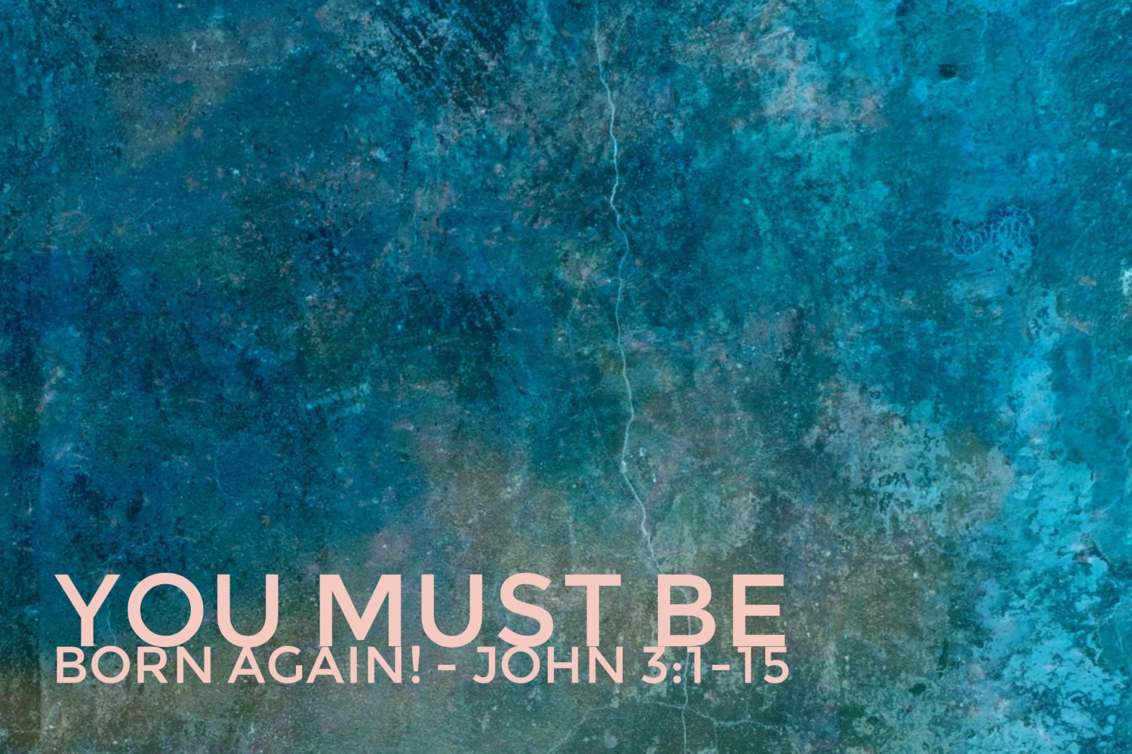
15

Slide 16
Born Again
Nicodemus was probably expecting a clarification of Jesus’ teaching or a further demonstration of His power.
Instead, Jesus’ response stretched Nicodemus’ understanding of spiritual matters.
Being born again was a foreign concept to most Jews.
They described new converts who had been baptized as being like newborn children, but faithful Jews saw no need to be born again.
They had already been born as children of Abraham.
They didn’t believe they needed a second birth.
16

Slide 17
Born Again
Jesus wanted Nicodemus to understand that the accident of being born into the right family and the right nation was not sufficient for salvation.
To experience eternal life, Nicodemus needed to be born both of water and the Spirit.
Water here probably refers to baptism.
Being born again requires the declaration of repentance as demonstrated in baptism, as well as the inner transformation and new life of the Spirit.
17

Slide 18
9 Nicodemus said to him, “How can these things be?” 10 Jesus answered him, “Are you a teacher of Israel, and yet you do not understand these things? 11 “Very truly, I tell you, we speak of what we know and testify to what we have seen; yet you do not receive our testimony. 12 If I have told you about earthly things and you do not believe, how can you believe if I tell you about heavenly things? 13 No one has ascended into heaven except the one who descended from heaven, the Son of Man. 14 And just as Moses lifted up the serpent in the wilderness, so must the Son of Man be lifted up, 15 that whoever believes in him may have eternal life. (John3:9-15)
18

Slide 19
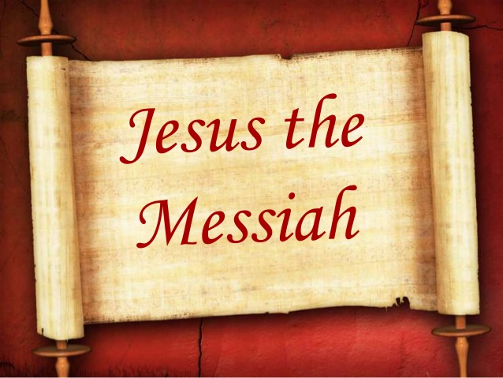
19

Slide 20
Jesus the Messiah
The Old Testament had spoken of the new covenant and the age of the Spirit the Messiah would bring.
Nicodemus failed to recognize Jesus as the Messiah because he did not accept Jesus’ witness about the Father, or the Father’s witness about the Son.
Those who reject God’s revelation of Himself in Jesus Christ cannot hear the voice of God and are blinded to His activity in our world.
Since He came from heaven, Jesus alone was qualified to speak about heavenly things.
Nicodemus needed to heed Jesus’ testimony—as do we.
20

Slide 21
21

Slide 22
Jesus Lifted Up
In the desert, God told Moses to put a bronze serpent on a pole in the middle of the camp.
Whoever was bitten by a snake and looked at the bronze serpent would live (Numbers 21:4–9).
Looking to the snake was a sign of repentance and of putting hope in God’s mercy.
In the same way, Jesus would be “lifted up” on the cross as a sign of God’s mercy.
Those who believe in Christ by faith and accept His sacrifice for their sins will receive God’s mercy and inherit eternal life.
22

Slide 23
16 “For God so loved the world that he gave his only Son, so that everyone who believes in him may not perish but may have eternal life. 17 “Indeed, God did not send the Son into the world to condemn the world, but in order that the world might be saved through him. 18 Those who believe in him are not condemned; but those who do not believe are condemned already, because they have not believed in the name of the only Son of God. 19 And this is the judgment, that the light has come into the world, and people loved darkness rather than light because their deeds were evil. 20 For all who do evil hate the light and do not come to the light, so that their deeds may not be exposed. 21 But those who do what is true come to the light, so that it may be clearly seen that their deeds have been done in God.” (John 3:16-21)
23

Slide 24
24

Slide 25
God’s Love, Mercy and Grace
The people of Israel had always understood themselves as God’s particularly beloved.
God’s gift of Jesus Christ was proof of His love for all peoples.
Everyone who believes in Him—regardless of what family or nation they were born into—can now be delivered from death and experience the gift of eternal life.
Our sin and rebellion against God have already placed us under God’s righteous judgment.
Those who repent and place their faith in Jesus can be delivered from condemnation.
Those who reject God’s gift of mercy and grace in Jesus continue to experience the condemnation they justly deserve.
25

Slide 26
Implications and Actions
Like Nicodemus, we may struggle to grasp the reality of who Jesus is and why He came.
We can cling to the truth that Jesus is the revelation of God’s love for us and our only source of eternal life.
We’ve all walked in darkness of our own making.
When we are brave enough to admit it, there is something in us we can’t shake—a sense of unworthiness, wrongness, and shame that never goes away.
Jesus came to change all that.
26

Slide 27
Implications and Actions
Eternal life is not just life in eternity with God.
Eternal life is something we experience today by living life with God through the gift of Jesus Christ.
We don’t have to be condemned.
We can experience the fullness of God’s love, mercy, and grace by confessing our sins, asking God to forgive us, and embracing Christ as our only hope of salvation.
27

Slide 28
Grace and Truth
Week 4
Crossing Barriers with Grace and Truth
28

Slide 29
Verses
4 From Mount Hor they set out by the way to the Red Sea, to go around the land of Edom. And the people became impatient on the way. 5 And the people spoke against God and against Moses, “Why have you brought us up out of Egypt to die in the wilderness? For there is no food and no water, and we loathe this worthless food.” 6 Then the Lord sent fiery serpents among the people, and they bit the people, so that many people of Israel died. 7 And the people came to Moses and said, “We have sinned, for we have spoken against the Lord and against you. Pray to the Lord, that he take away the serpents from us.” So Moses prayed for the people. 8 And the Lord said to Moses, “Make a fiery serpent and set it on a pole, and everyone who is bitten, when he sees it, shall live.” 9 So Moses made a bronze serpent and set it on a pole. And if a serpent bit anyone, he would look at the bronze serpent and live. (Numbers 21:4-9)
30

