Slide 1
Music
Christ the Lord is Risen Today (Joslin Grove Choral Society)
Victory in Jesus (Grace Point Worship)
1

Slide 2
Week 11
It is Finished
2

Slide 3
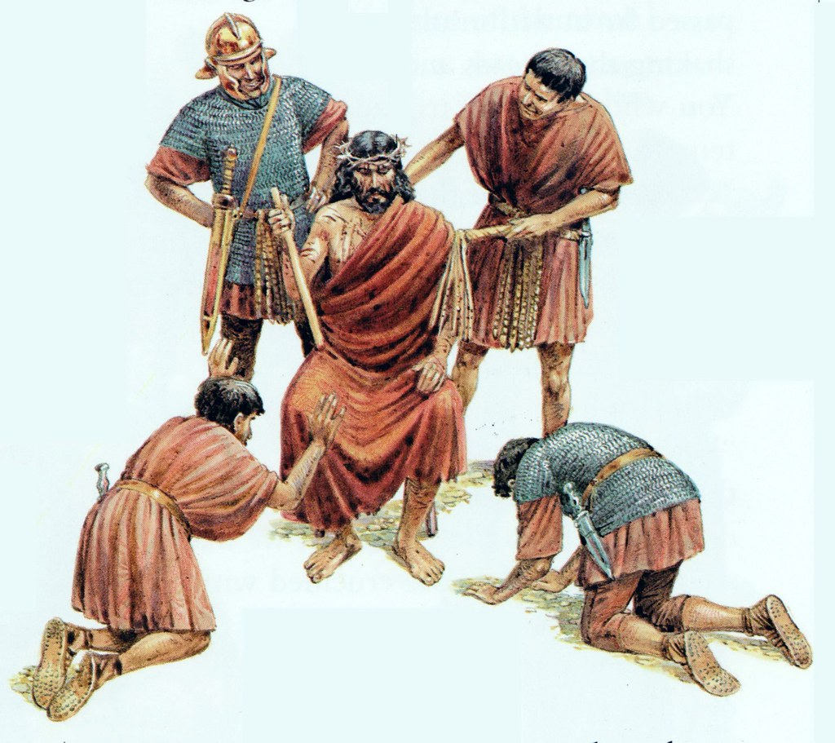
Pilate made several failed attempts to satisfy the Jews which only resulted in an even louder cry from the crowd, “Crucify Him!”
3

Slide 4
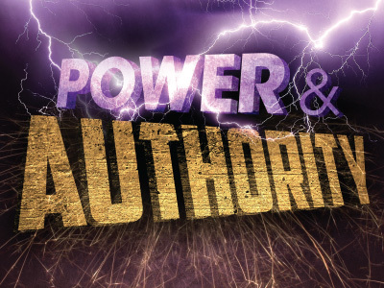
Jesus reminded Pilate that God had given him his power, and God would control everything that would happen, not Pilate.
4

Slide 5
Afraid of losing his position (or even worse), Pilate gave into the demands of the Jews and called for the crucifixion of Jesus.
5

Slide 6
Jesus could rightly take the title King of the Jews, but because Jesus was not what they wanted, “his own people did not receive him”.
6

Slide 7
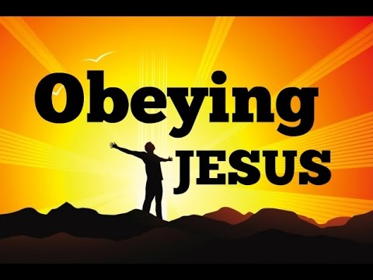
John demonstrated what an honor it is obey Jesus without complaining, asking questions, or hesitating.
7

Slide 8
All Jesus had come to do was accomplished.
8

Slide 9
Implications and Actions
The word redemption means “to gain or regain possession of something in exchange for payment or clearing a debt.”
We were all born sinful, and our sin separates us from God and His love.
We are powerless to pay the debt of sin we owe to God.
The Father sent his Son Jesus to pay our sin debt.
To be right with God we must believe and accept that Jesus paid our price, and by this God gains possession of us.
There is nothing left to do; there is nothing we can add.
Because of Jesus, we can belong to God.
9

Slide 10
Week 12
I Have Seen the Lord
10

Slide 11
1 Early on the first day of the week, while it was still dark, Mary Magdalene went to the tomb and saw that the stone had been removed from the entrance. (John 20:1)
11

Slide 12
12

Slide 13
Where Was Jesus for the Three Days?
Jesus’ body was in the tomb, but His Spirit, having departed at His death (Matthew 27:50), was elsewhere for those three days.
The Bible tells us that Jesus comforted the departed faithful followers and brought them to their eternal home (Ephesians 4:8), and proclaimed His victory over the unsaved who are kept in prison (1 Peter 3:19).
Jesus was not giving anyone a second chance for salvation; we face judgment after death (Hebrews 9:27), not a second chance.
The NAS Bible says that Jesus went to “Hades” (Acts 2:31), but Hades is not hell.
Hades is a temporary place, the lake of fire (hell) is the permanent, final place of judgment for the lost.
13

Slide 14
2 So she came running to Simon Peter and the other disciple, the one Jesus loved, and said, “They have taken the Lord out of the tomb, and we don’t know where they have put him!” 3 So Peter and the other disciple started for the tomb. 4 Both were running, but the other disciple outran Peter and reached the tomb first.5 He bent over and looked in at the strips of linen lying there but did not go in. 6 Then Simon Peter came along behind him and went straight into the tomb. He saw the strips of linen lying there, 7 as well as the cloth that had been wrapped around Jesus’ head. The cloth was still lying in its place, separate from the linen. 8 Finally the other disciple, who had reached the tomb first, also went inside. He saw and believed. 9 (They still did not understand from Scripture that Jesus had to rise from the dead.) (John 20:2–9)
14

Slide 15
15

Slide 16
Jesus is Alive
Jews in Palestine customarily visited the tomb of a loved one for the first three days after burial, believing the spirit of the deceased remained until the body began to decay.
Jesus had stated that if they destroyed the temple (referring to His body), He would raise it in three days.
On several occasions Jesus explained to His disciples that He would die and rise again.
John believed Jesus was alive, not because of His words, but because of His empty grave clothes.
John based his faith on the evidence before him.
16

Slide 17
11 Now Mary stood outside the tomb crying. As she wept, she bent over to look into the tomb 12 and saw two angels in white, seated where Jesus’ body had been, one at the head and the other at the foot. 13 They asked her, “Woman, why are you crying?” “They have taken my Lord away,” she said, “and I don’t know where they have put him.” 14 At this, she turned around and saw Jesus standing there, but she did not realize that it was Jesus. 15 He asked her, “Woman, why are you crying? Who is it you are looking for?” Thinking he was the gardener, she said, “Sir, if you have carried him away, tell me where you have put him, and I will get him.” 16 Jesus said to her, “Mary.” She turned toward him and cried out in Aramaic, “Rabboni!” (which means “Teacher”). (John 20:11–16)
17

Slide 18
18

Slide 19
Celebrate Jesus
Mary did not recognize the men inside the tomb as angels.
Her main concern was finding the body of Jesus.
The angels understood the empty tomb was a reason to rejoice, not weep.
Mary was poised to continue her search when she saw Jesus.
The moment Jesus called her by name she realized who was standing in front of her.
Imagine the overwhelming flood of emotion Mary experienced as her tears of sorrow turned into tears of celebration!
19

Slide 20
17 Jesus said, “Do not hold on to me, for I have not yet ascended to the Father. Go instead to my brothers and tell them, ‘I am ascending to my Father and your Father, to my God and your God.’” 18 Mary Magdalene went to the disciples with the news: “I have seen the Lord!” And she told them that he had said these things to her. (John 20:17–18)
20

Slide 21
21

Slide 22
Resurrection Power
Jesus calmed Mary by letting her know it was okay to let Him go.
One reason she could let go was that this encounter would not be the last time Mary would see Him.
Jesus remained on the earth for forty days before He ascended to heaven to sit at the right hand of God.
The second reason was that Mary needed to tell others.
Mary encountered the risen Savior and He commissioned her to tell His brothers that He was alive.
In the past, Jesus referred to His followers as servants or friends.
Because they would now share in the power of the resurrection, Jesus called them His brothers.
22

Slide 23
19 On the evening of that first day of the week, when the disciples were together, with the doors locked for fear of the Jewish leaders, Jesus came and stood among them and said, “Peace be with you!” 20 After he said this, he showed them his hands and side. The disciples were overjoyed when they saw the Lord. 21 Again Jesus said, “Peace be with you! As the Father has sent me, I am sending you.” (John 20:19–21)
23

Slide 24
24

Slide 25
Jesus Brings Peace
The disciples, like Mary, had to see Jesus to believe He had risen.
Jesus turned the disciples’ fear into courage.
His first words to His disciples were words of peace.
Jesus did not rebuke them for abandoning Him, but spoke peace over them.
His words of peace were not just for the moment; they were for eternity.
His death and resurrection had brought peace to the world.
Sin and death were defeated, and the created could experience everlasting peace with the Creator.
25

Slide 26
Implications and Actions
Mary and the disciples believed because they saw the resurrected Jesus.
Although we cannot see Jesus today, He reveals himself through the eyewitness accounts in the Bible and through the Holy Spirit, who speaks the truth of Jesus to our spirits.
Jesus removes our fear by making it possible to have a right relationship with God.
He has also given us a purpose: to go to all nations and make disciples by telling the world what we have seen and heard.
The peace we have in Jesus is what He offers to everyone.
26

Slide 27
Week 13
A Remarkable Catch and a Gracious Restoration
27

Slide 28
Verses
50 And Jesus cried out again with a loud voice and yielded up his spirit. (Matthew 27:50)
28

Slide 29
Verses
27 And just as it is appointed for man to die once, and after that comes judgment (Hebrews 9:27)
29

Slide 30
Verses
31 he foresaw and spoke about the resurrection of the Christ, that he was not abandoned to Hades, nor did his flesh see corruption. (Acts 2:31)
30

Slide 31
Verses
19 in which he went and proclaimed to the spirits in prison, (1 Peter 3:19)
31

Slide 32
Verses
8 Therefore it says, “When he ascended on high he led a host of captives, and he gave gifts to men.” (Ephesians 4:8)
31

