Slide 1
Music
I Choose Jesus (Moriah Peters)
The Hurt & The Healer (MercyMe)
1

Slide 2
Grace and Truth
Week 4
Crossing Barriers with Grace and Truth
2

Slide 3
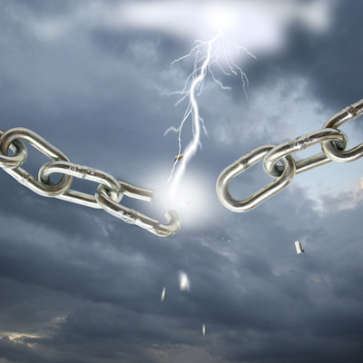
3

Slide 4
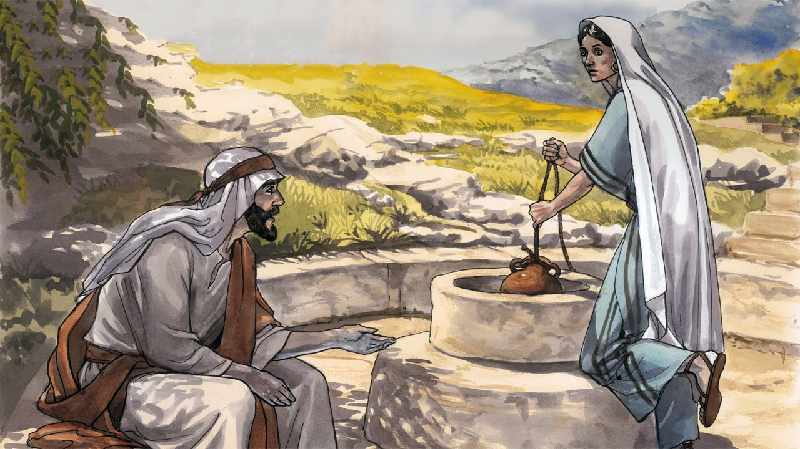
4

Slide 5
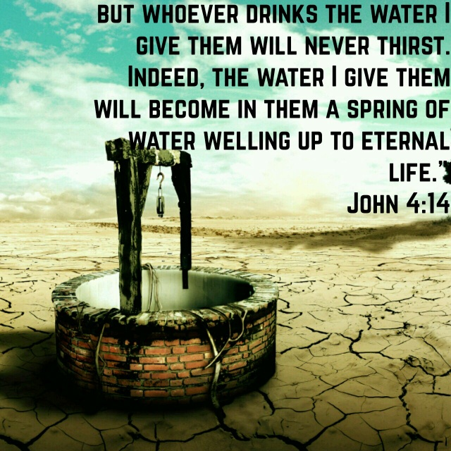
5

Slide 6
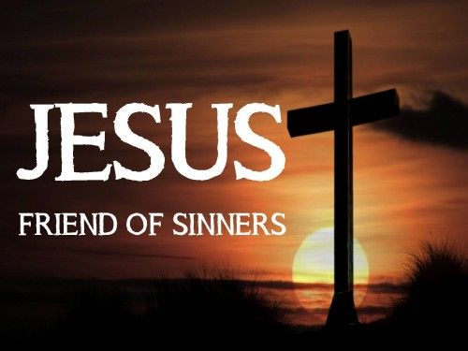
6

Slide 7

7

Slide 8
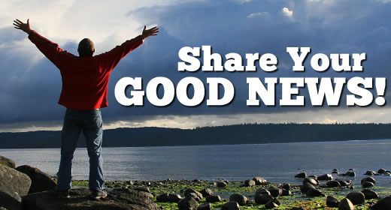
8

Slide 9
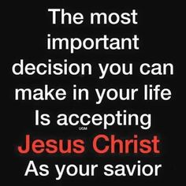
9

Slide 10
Implications and Actions
We can never know how someone will respond to the gospel.
Although He crossed boundaries, Jesus never compromised truth.
Jesus’ willingness to break barriers to share the gospel led to a spiritual harvest.
We can follow Jesus’ example by crossing barriers to share the gospel with grace and truth.
When we follow the Spirit’s leadership in our lives, God may prompt us to leave our comfort zones to offer grace and truth where it is needed most.
When we do, we can also reap a bountiful harvest.
10

Slide 11
Grace and Truth
Week 5
Do You Want to Get Well?
11

Slide 12
1 Some time later, Jesus went up to Jerusalem for one of the Jewish festivals. 2 Now there is in Jerusalem near the Sheep Gate a pool, which in Aramaic is called Bethesda and which is surrounded by five covered colonnades. 3 Here a great number of disabled people used to lie - the blind, the lame, the paralyzed. 5 One who was there had been an invalid for thirty-eight years. (John 5:1–5)
12

Slide 13
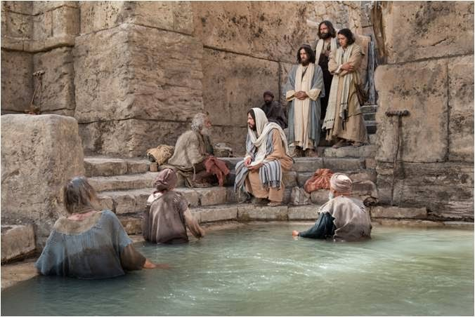
13

Slide 14
Pool at Bethesda
In Jerusalem, Jesus made his way to a renowned pool named “Bethesda,” which is Aramaic for house of mercy.
There, an underground spring at times churned the water of this particular pool, and when the water swirled people believed it had magical healing powers.
People always encircled the pool, waiting for the underground spring to stir the water.
14

Slide 15
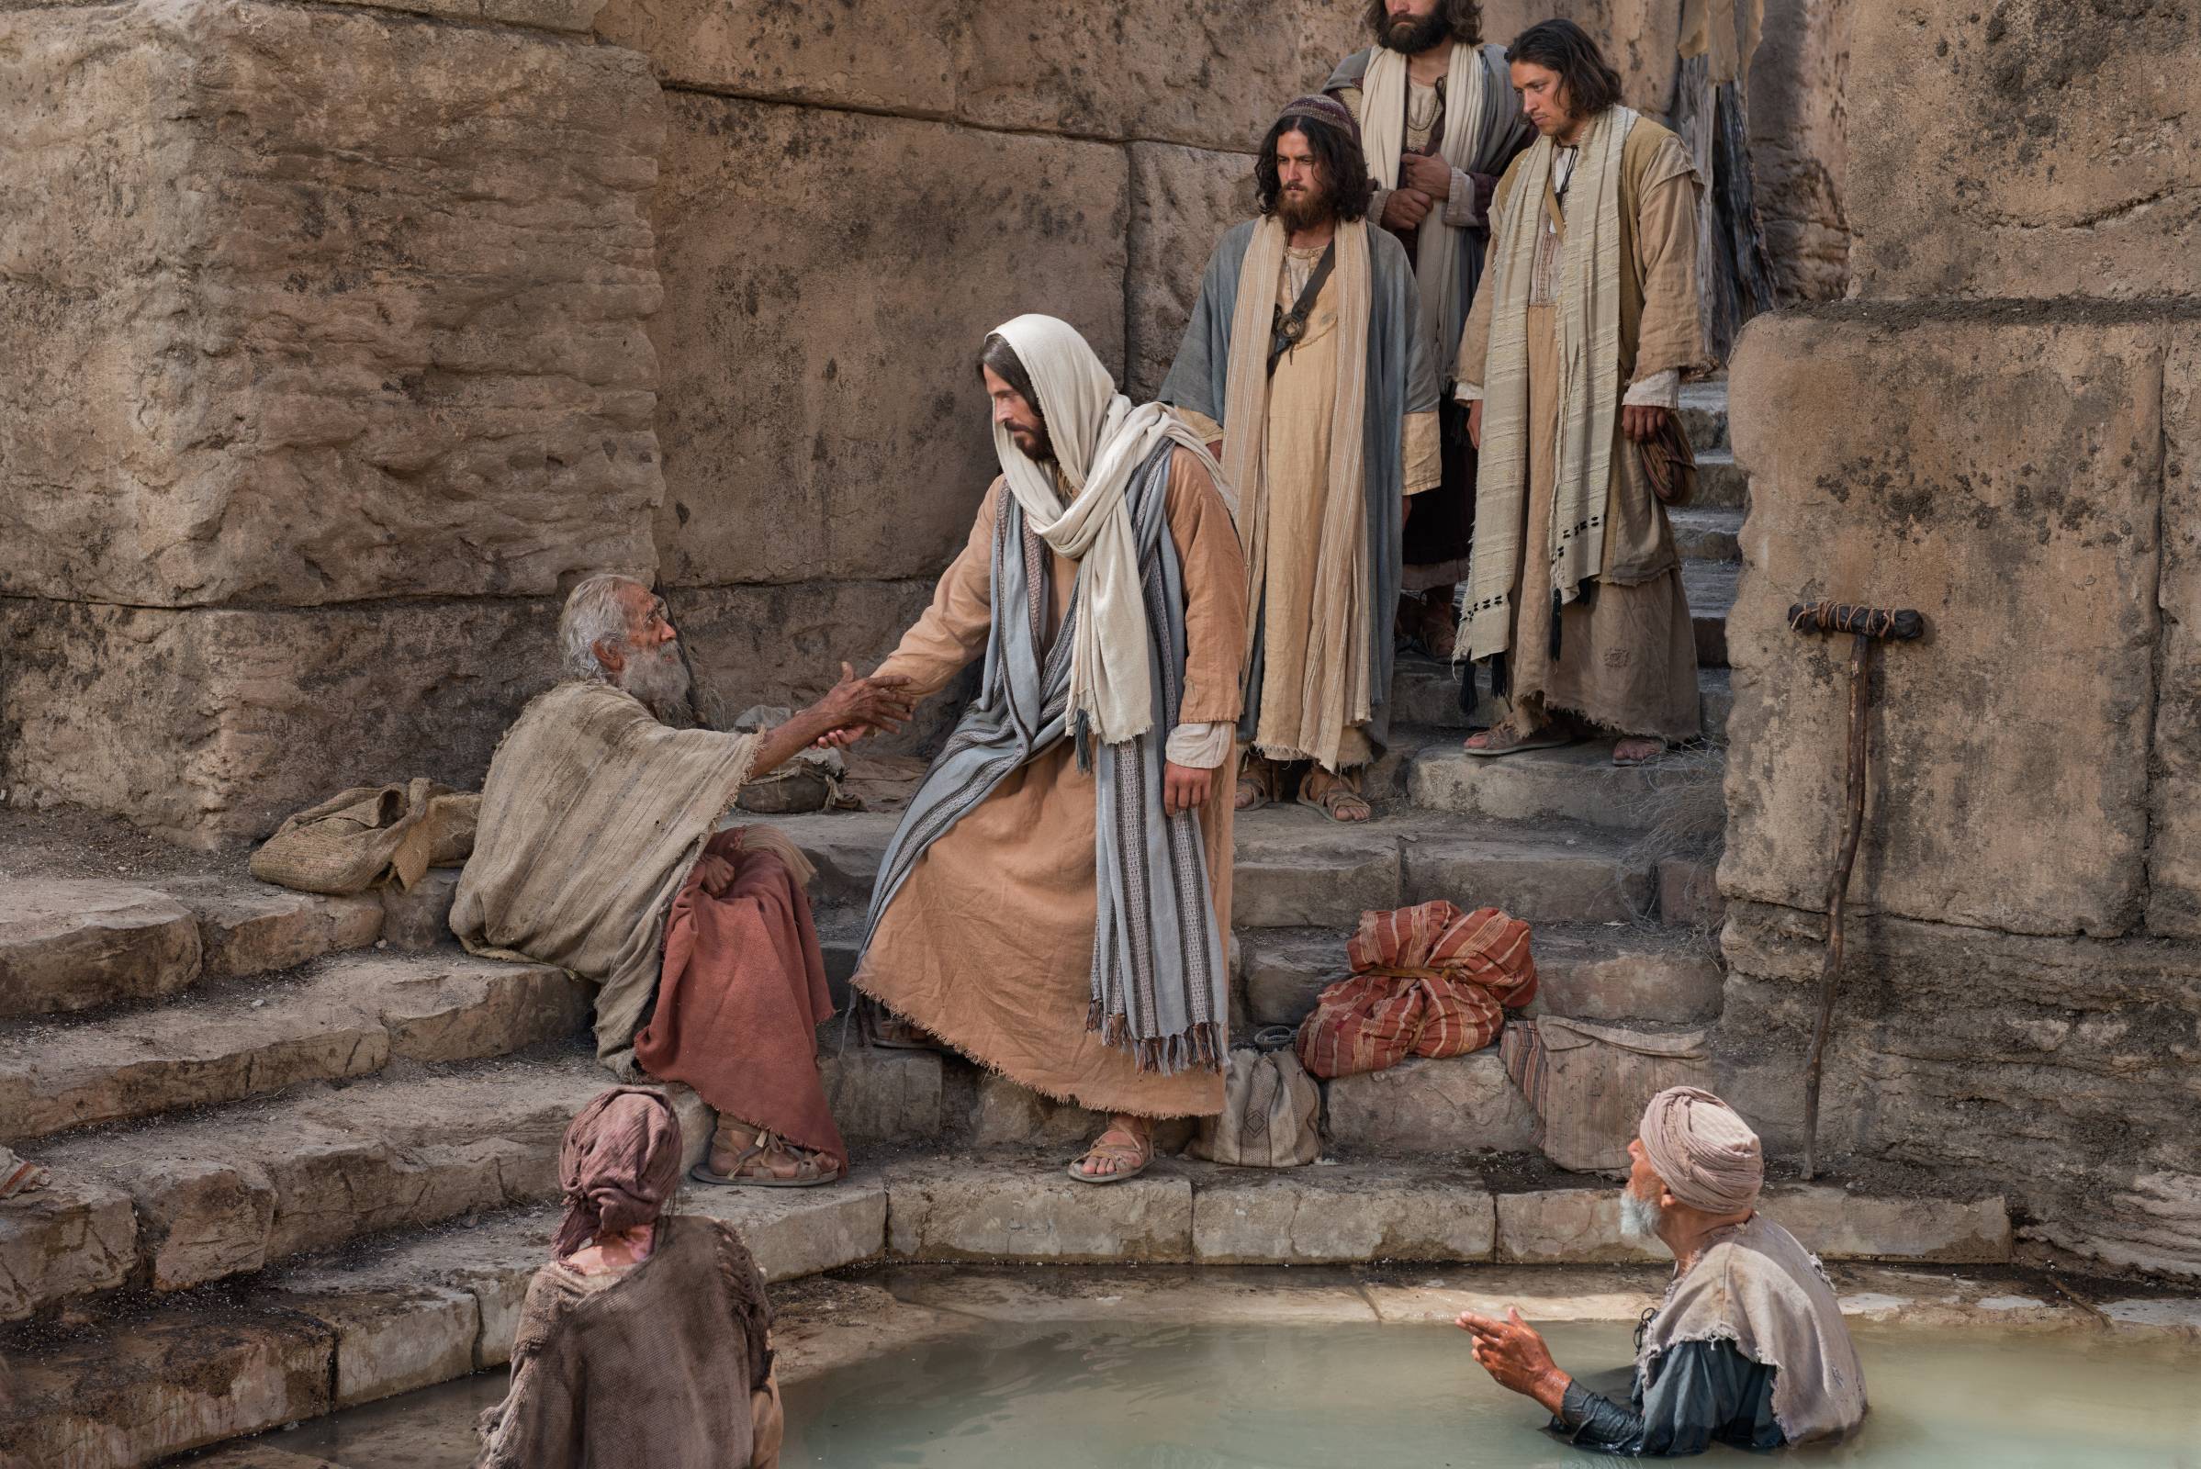
15

Slide 16
Miracle of Healing
Jesus encountered a man who was lying on a mat near the pool of Bethesda.
The man was unable to move himself, and when the water swirled, he remained motionless on his mat while others rushed into the water.
Jesus felt compassion for him.
It was a perfect opportunity for Jesus to help someone and teach a valuable lesson at the same time.
Jesus wanted to reveal His identify and explain where He had come from and what He had come to do.
16

Slide 17
6 When Jesus saw him lying there and learned that he had been in this condition for a long time, he asked him, “Do you want to get well?” 7 “Sir,” the invalid replied, “I have no one to help me into the pool when the water is stirred. While I am trying to get in, someone else goes down ahead of me.” 8 Then Jesus said to him, “Get up! Pick up your mat and walk.” 9 At once the man was cured; he picked up his mat and walked. The day on which this took place was a Sabbath. (John 5:6-9)
17

Slide 18
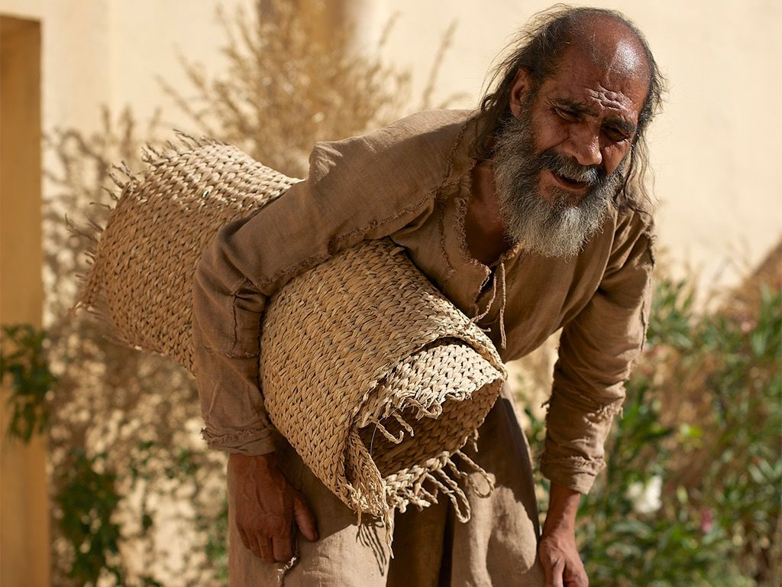
18

Slide 19
Do You Want to Get Well?
Before He healed the man with paralysis, Jesus asked him this essential question: “Do you want to get well?”
Jesus asks all of us, “Do you want to be healed from your sins?”
The foundation of this vital question is related to faith and hope.
The man had placed his trust in the magical waters of the pool of Bethesda (house of mercy)—and eventually lost hope.
He needed only to place his faith in Jesus to see his dreams fulfilled.
The emphasis of this healing was not his faith, but the power and authority of Jesus over all things, including the Mosaic Law.
19

Slide 20
10 and so the Jewish leaders said to the man who had been healed, “It is the Sabbath; the law forbids you to carry your mat.” 11 But he replied, “The man who made me well said to me, ‘Pick up your mat and walk.’ ” 12 So they asked him, “Who is this fellow who told you to pick it up and walk?” 13 The man who was healed had no idea who it was, for Jesus had slipped away into the crowd that was there. 14 Later Jesus found him at the temple and said to him, “See, you are well again. Stop sinning or something worse may happen to you.” 15 The man went away and told the Jewish leaders that it was Jesus who had made him well. 16 So, because Jesus was doing these things on the Sabbath, the Jewish leaders began to persecute him. (John 5:10-16)
20

Slide 21

21

Slide 22
Letter versus Spirit of the Law
Rather than celebrate the healing, the Pharisees chose to chastise the healed man for carrying his mat on the Sabbath.
This was considered an act of work, thus violating the law.
They were more concerned with the letter of the law, the dos and don’ts of religiosity, than with human life and suffering.
The way Pharisees saw it, Jesus was placing a human need above the importance of the Mosaic Law.
Jesus believed that when the law conflicted with loving a friend, a stranger, or even the enemy, the act of love subjugated the law.
For Jesus, healing someone was always an act of love.
22

Slide 23
17 In his defense Jesus said to them, “My Father is always at his work to this very day, and I too am working.” 18 For this reason they tried all the more to kill him; not only was he breaking the Sabbath, but he was even calling God his own Father, making himself equal with God. 19 Jesus gave them this answer: “Very truly I tell you, the Son can do nothing by himself; he can do only what he sees his Father doing, because whatever the Father does the Son also does. 20 For the Father loves the Son and shows him all he does. Yes, and he will show him even greater works than these, so that you will be amazed. 21 For just as the Father raises the dead and gives them life, even so the Son gives life to whom he is pleased to give it. (John 5:17-21)
23

Slide 24
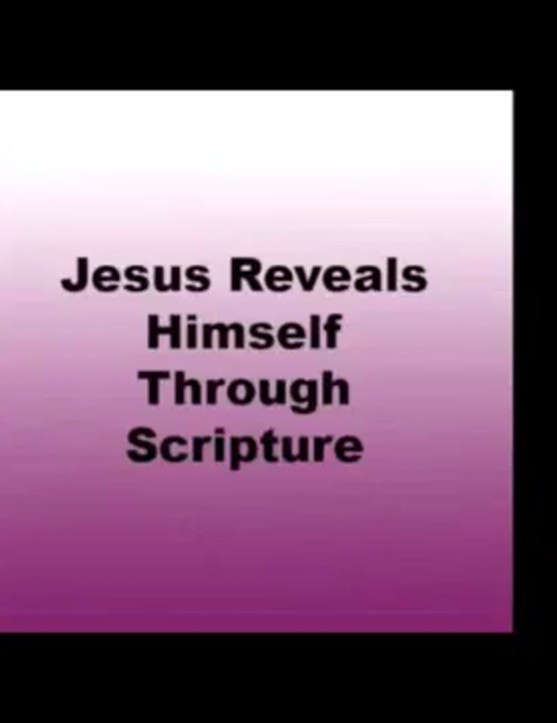
24

Slide 25
Jesus Reveals His Identity, Authority & Mission
Identity
  God is always at work in the world, and those who follow God must join Him in that work.
  The work of God supersedes the Sabbath laws.
Authority
  Jesus mission was to seek and save the lost. (Luke 19:10)
  He came to bring good news to the poor.
  The Spirit of the Lord sent Jesus to proclaim release to the captives and recovery of sight to the blind, to let the oppressed go free. (Luke 4:18–19)
25

Slide 26
Jesus Reveals His Identity, Authority & Mission
Mission
  This work was Jesus’ singular focus, and anything that got in the way—including the Mosaic Law—was secondary.
  Jesus believed that only in being true to his singular mission, could he be faithful to the spirit of the Mosaic Law.
26

Slide 27
22 Moreover, the Father judges no one, but has entrusted all judgment to the Son, 23 that all may honor the Son just as they honor the Father. Whoever does not honor the Son does not honor the Father, who sent him. 24 “Very truly I tell you, whoever hears my word and believes him who sent me has eternal life and will not be judged but has crossed over from death to life. (John 5:22-24)
27

Slide 28
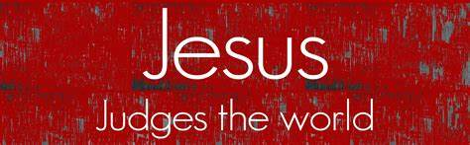
28

Slide 29
Jesus Judges the World
Jesus regularly chastised the Pharisees for focusing on the keeping of the minutia of the law, while violating the spirit of it. (Matthew 23:24)
He called them hypocrites for oppressing the poor people of the land with an overly burdensome law, but doing nothing to help them follow it. (Matthew 23:4)
Some of the Pharisees were good at finding loopholes in the Mosaic Law that allowed them to violate it while pretending to follow it. (Mark 7:13)
29

Slide 30
Implications and Actions
Jesus believed the essential thing in life was to love God and love others by helping them.
He understood that His primary mission on earth was to seek and save the lost.
He saw everything else, including the Mosaic Law, as secondary to that mission.
Jesus saw himself as the fulfillment of the law, and therefore, superior to it.
He preferred to follow the spirit of the law rather than the letter of the law.
30

Slide 31
Implications and Actions
Whenever the law came into conflict with helping others, Jesus was always quick to set aside the law, in deference to love.
Jesus calls us to love God and love and care about people above everything else in life.
It is vital to ensure that we are not allowing human-made rules to override the voice of the Holy Spirit and our primary mission: to share the love of God with a lost world.
31

Slide 32
Grace and Truth
Week 5
Do You Want to Get Well?
32

Slide 33
Verses
10 For the Son of Man came to seek and to save the lost.” (Luke 19:10)
18 “The Spirit of the Lord is upon me, because he has anointed me to proclaim good news to the poor. He has sent me to proclaim liberty to the captives and recovering of sight to the blind, to set at liberty those who are oppressed, 19 to proclaim the year of the Lord's favor.” (Luke 4:18-19)

Slide 34
Verses
24 You blind guides, straining out a gnat and swallowing a camel! (Matthew 23:24)
4 They tie up heavy burdens, hard to bear, and lay them on people's shoulders, but they themselves are not willing to move them with their finger. (Matthew 23:4)
13 thus making void the word of God by your tradition that you have handed down. And many such things you do.” (Mark 7:13)

