Slide 1
Music
Take My Life and Let It Be (Vineyard Worship)
Nothing But The Blood (HeartCry Worship)
1

Slide 2
Grace and Truth
Week 8
Committed to the Task
8

Slide 3

“we would like to see Jesus.”
10

Slide 4
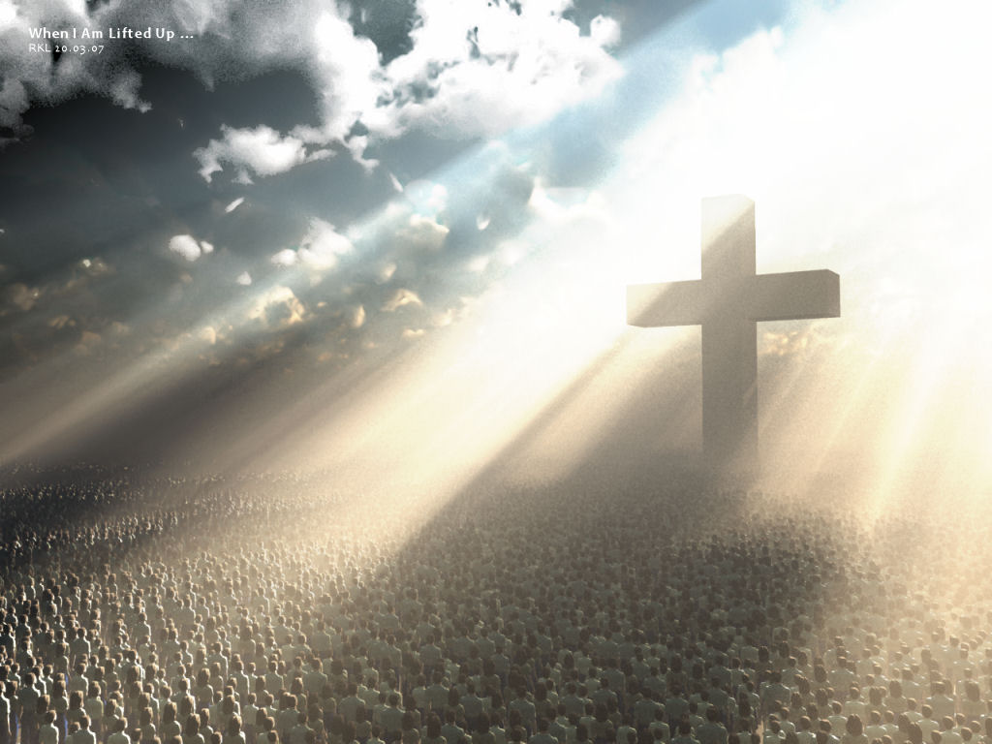
Jesus Glorified
13

Slide 5

Results in humility and self-sacrifice.
16

Slide 6

19

Slide 7

Every person can receive grace through faith in Christ,
but not all choose to do so.
22

Slide 8

Choosing to remain quiet instead of risking rejection.
25

Slide 9

Believe in Jesus
and
receive everlasting life.
28

Slide 10
Implications and Actions
Christians today are called to follow Jesus’ example of resolute commitment.
We can either choose to pursue God’s glory or ours, but we cannot pursue both.
Should we choose to die to ourselves, we will experience the life God intends for His beloved children, a life of intimacy and obedience to the Father.
While an earthly bucket list may be filled with worldly activities, loving and pursing God are the only two critical pursuits for a believer.
30

Slide 11
Grace and Truth
Week 9
Follow Jesus’ Example
31

Slide 12
1 It was just before the Passover Festival. Jesus knew that the hour had come for him to leave this world and go to the Father. Having loved his own who were in the world, he loved them to the end. (John 13:1)
9

Slide 13

10

Slide 14
Jesus Loved His Disciples
Knowing what lay ahead did not deter Jesus from making the most of the time he had left with His disciples.
Jesus’ actions on that night demonstrated the depth of His love for His inner circle and His desire to teach them until His death.
Jesus demonstrated His love for them and us when He bore their sin and the sin of the world on the cross.
11

Slide 15
2 The evening meal was in progress, and the devil had already prompted Judas, the son of Simon Iscariot, to betray Jesus. 3 Jesus knew that the Father had put all things under his power, and that he had come from God and was returning to God; (John 13:2-3)
9

Slide 16

13

Slide 17
Serving God and Serving Others
Jesus knew that “the Father had put all things under His power”, where He had come from and where He was going.
Jesus would rely on both truths as He faced unspeakable pain and torture.
Knowing His authority and His real home would give Him greater resolve.
Since we are created in the image of God, all authority comes from Him, and our ultimate end is heaven, serving others should come more easily.
We do not have to worry about impressing others or competing for power or titles.
14

Slide 18
4 so he got up from the meal, took off his outer clothing, and wrapped a towel around his waist. 5 After that, he poured water into a basin and began to wash his disciples’ feet, drying them with the towel that was wrapped around him. 6 He came to Simon Peter, who said to him, “Lord, are you going to wash my feet?” 7 Jesus replied, “You do not realize now what I am doing, but later you will understand.” 8 “No,” said Peter, “you shall never wash my feet.” Jesus answered, “Unless I wash you, you have no part with me.” 9 “Then, Lord,” Simon Peter replied, “not just my feet but my hands and my head as well!” 10 Jesus answered, “Those who have had a bath need only to wash their feet; their whole body is clean. And you are clean, though not every one of you.” 11 For he knew who was going to betray him, and that was why he said not every one was clean. (John 13:4-11)
12

Slide 19
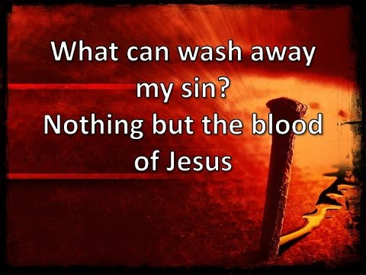
16

Slide 20
Wash Away Sin
Washing someone’s feet was typically done before a meal by the least of the household servants.
Jesus’ act of service likely made all the disciples uncomfortable.
Jesus gave Peter an ultimatum - either let Him wash his feet or don’t have anything to do with Jesus.
Jesus was helping Peter and the other disciples to understand that the cleansing of their feet symbolized what Jesus would ultimately do - cleanse their souls with his blood.
If the disciples could not accept the self-sacrifice involved in washing somebody’s feet, they could not possibly accept the ultimate act of service - Jesus’ substitutionary death.
14

Slide 21
12 When he had finished washing their feet, he put on his clothes and returned to his place. “Do you understand what I have done for you?” he asked them. 13 “You call me ‘Teacher’ and ‘Lord,’ and rightly so, for that is what I am. 14 Now that I, your Lord and Teacher, have washed your feet, you also should wash one another’s feet. 15 I have set you an example that you should do as I have done for you. 16 Very truly I tell you, no servant is greater than his master, nor is a messenger greater than the one who sent him. 17 Now that you know these things, you will be blessed if you do them. (John 13:12-17)
15

Slide 22

19

Slide 23
Humble Service
The disciples had called Jesus a teacher/rabbi, a term used for those who offered religious instruction in the temple.
Jesus challenged His disciples to follow in His footsteps, not only in their actions but also in their attitudes.
They would have had no problem washing their rabbi’s feet as an act of devotion, love, and gratitude.
However, to clean someone else’s feet required profound humility.
Just as Jesus left the table to serve His disciples, Jesus left heaven to come to earth and humbly serve humanity.
17

Slide 24
Implications and Actions
The ultimate act of servanthood came when Jesus died on the cross for all of humanity—even those who would despise and reject him.
Believers are called to serve with that same openness and love for all.
30

Slide 25
Grace and Truth
Week 10
The Coming Counselor
31

Slide 26
Verses
.
24

