Slide 1
Music
Trust and Obey (Don Moen)
Holy Spirit (Francesca Battistelli)
1

Slide 2
Grace and Truth
Week 9
Follow Jesus’ Example
2

Slide 3
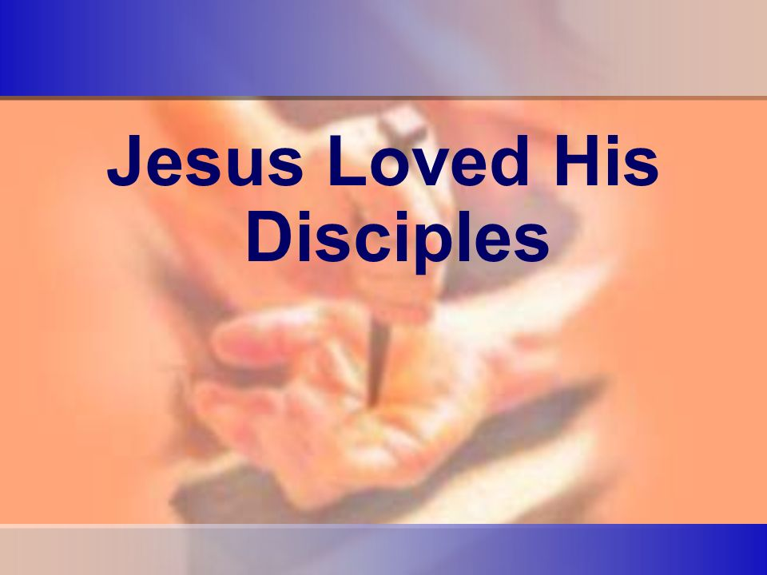
Jesus demonstrated His love when He bore the sin of the world on the cross.
3

Slide 4

Since we are created in the image of God, all authority comes from Him, and our ultimate end is heaven, serving others should come more easily.
4

Slide 5
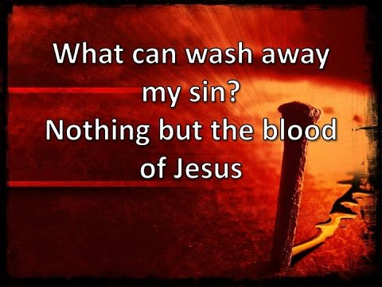
Cleansing of the disciples feet symbolized what Jesus would ultimately do - cleanse our souls with His blood.
5

Slide 6

To clean someone else’s feet requires profound humility.
6

Slide 7
Implications and Actions
The ultimate act of servanthood came when Jesus died on the cross for all of humanity—even those who would despise and reject him.
Believers are called to serve with that same openness and love for all.
7

Slide 8
Grace and Truth
Week 10
The Coming Counselor
8

Slide 9
15 “If you love me, keep my commands. (John 14:15)
9

Slide 10

10

Slide 11
Greatest Commandment
In Matthew 22:35 - 39, Jesus explained that the greatest commandment was to love God unreservedly; and secondly, to love others and one’s self.
Jesus didn’t ask His disciples to follow a list of things to do to show devotion to Him.
His command was simple: if you love Me, you’ll obey Me. Such obedience is not burdensome.
In light of the height, depth, length, and breadth of God’s love for believers, loving Him and obeying Him becomes easier.
Love is the birthplace of obedience. Fear, shame, regret, and insecurity cannot produce genuine love.
11

Slide 12
16 And I will ask the Father, and he will give you another advocate to help you and be with you forever - 17 the Spirit of truth. The world cannot accept him, because it neither sees him nor knows him. But you know him, for he lives with you and will be in you. 18 I will not leave you as orphans; I will come to you. 19 Before long, the world will not see me anymore, but you will see me. Because I live, you also will live. 20 On that day you will realize that I am in my Father, and you are in me, and I am in you. (John 14:15 – 20)
12

Slide 13

13

Slide 14
The Holy Spirit Lives in Us
Jesus described the person and work of the Holy Spirit.
Jesus understood that the disciples would need this information and encouragement.
They would need the Holy Spirit as they tried to grapple with the crucifixion and death of their beloved teacher.
Jesus promised the Holy Spirit would reside with believers forever.
This ongoing presence would be a pivotal change from the way the Holy Spirit had dwelt among God’s people.
14

Slide 15
21 Whoever has my commands and keeps them is the one who loves me. The one who loves me will be loved by my Father, and I too will love them and show myself to them.” 22 Then Judas (not Judas Iscariot) said, “But, Lord, why do you intend to show yourself to us and not to the world?” 23 Jesus replied, “Anyone who loves me will obey my teaching. My Father will love them, and we will come to them and make our home with them. 24 Anyone who does not love me will not obey my teaching. These words you hear are not my own; they belong to the Father who sent me. (John 14:21 - 24)
15

Slide 16

16

Slide 17
Intimacy With God
Jesus was not saying that God’s love is contingent on a person’s obedience.
Jesus understood that loving Him is equal to loving the Father, and vice versa.
Believers who experience a growing relationship with God will see new aspects of God’s character.
The believer and God experience a deepening of love, obedience, and growth.
Such intimacy is only possible through the indwelling of the Holy Spirit, who reveals God’s heart to each believer.
17

Slide 18
25 “All this I have spoken while still with you. 26 But the Advocate, the Holy Spirit, whom the Father will send in my name, will teach you all things and will remind you of everything I have said to you. 27 Peace I leave with you; my peace I give you. I do not give to you as the world gives. Do not let your hearts be troubled and do not be afraid. (John 14:25 - 27)
18

Slide 19

19

Slide 20
Work of the Holy Spirit
Jesus explained that the Spirit would continue to teach the disciples and remind them of Jesus’ instruction.
The Spirit does the same thing in believers’ lives today.
When a believer recalls a part of a sermon or Bible study, that recollection is the work of the Holy Spirit.
When a Christian evokes a timely Scripture to comfort or help a friend, the Holy Spirit is the one who brings the passage to mind.
20

Slide 21
28 “You heard me say, ‘I am going away and I am coming back to you.’ If you loved me, you would be glad that I am going to the Father, for the Father is greater than I. 29 I have told you now before it happens, so that when it does happen you will believe. (John 14:28 - 29)
21

Slide 22
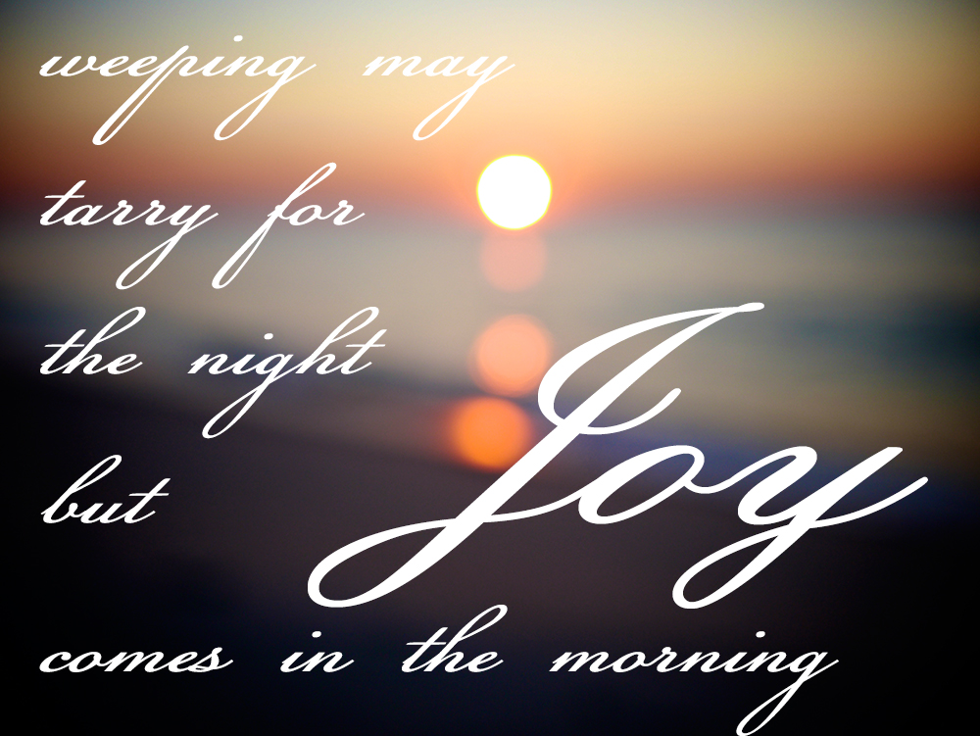
22

Slide 23
Joy and Comfort
Although Jesus was going back to His rightful place in heaven with God and His disciples would grieve deeply, Jesus said they would be glad.
This mixture of feelings is just as prevalent today as it was then.
When a believer dies, friends and family feel sadness in not seeing that person.
At the same time, those loved ones can find joy and take comfort in knowing that the deceased has gone to heaven.
23

Slide 24
30 I will not say much more to you, for the prince of this world is coming. He has no hold over me,31 but he comes so that the world may learn that I love the Father and do exactly what my Father has commanded me. “Come now; let us leave. (John 14:30 - 31)
24

Slide 25
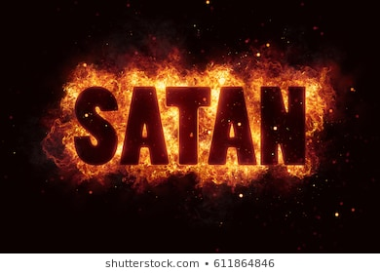
25

Slide 26
Satan
The phrase, “prince of this world” describes Satan.
Jesus used this title to highlight just how powerful an enemy Satan is.
He was not afraid of Satan or his influence on the world.
Instead, Jesus said that the devil’s role in the death of Jesus would show the world that Jesus loved and obeyed the Father.
No power, no person, no act in history is beyond the sovereignty of God.
The suffering and death of Jesus was a part of God’s plan to buy back His beloved children from the slavery of sin and death.
26

Slide 27
Implications and Actions
When a person becomes a Christian, the Holy Spirit comes to live within that believer.
Jesus promised that the Holy Spirit would stay with Christians forever.
He will guide them into all truth—as long as they are willing to listen.
Too many times, believers are too busy leading noisy lives to be able to hear the still, small voice of God.
The Holy Spirit will comfort, guide, direct, and encourage those who take the time to stop and pay attention.
27

Slide 28
Grace and Truth
Week 10
It is Finished
28

Slide 29
Verses
35 And one of them, a lawyer, asked him a question to test him. 36 “Teacher, which is the great commandment in the Law?” 37 And he said to him, “You shall love the Lord your God with all your heart and with all your soul and with all your mind. 38 This is the great and first commandment. 39 And a second is like it: You shall love your neighbor as yourself. (Matthew 22:35-39)
29

