Slide 1
Music
There is Power in the Blood (Buddy Jewell)
It Is Finished (Matt Birkenfeld)
1

Slide 2
Week 10
The Coming Counselor
3

Slide 3
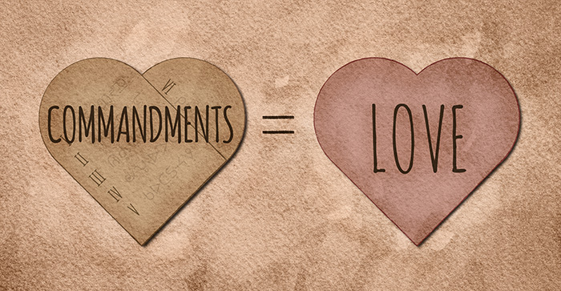
Jesus’ command was simple: if you love Me, you’ll obey Me.
Such obedience is not burdensome.
3

Slide 4
Jesus promised the Holy Spirit would reside with believers forever.
4

Slide 5
Intimacy is only possible through the indwelling of the Holy Spirit, who reveals God’s heart to each believer.
5

Slide 6
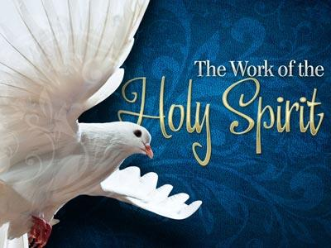
The Spirit continues to teach believers and reminds them of Jesus’ instruction.
6

Slide 7
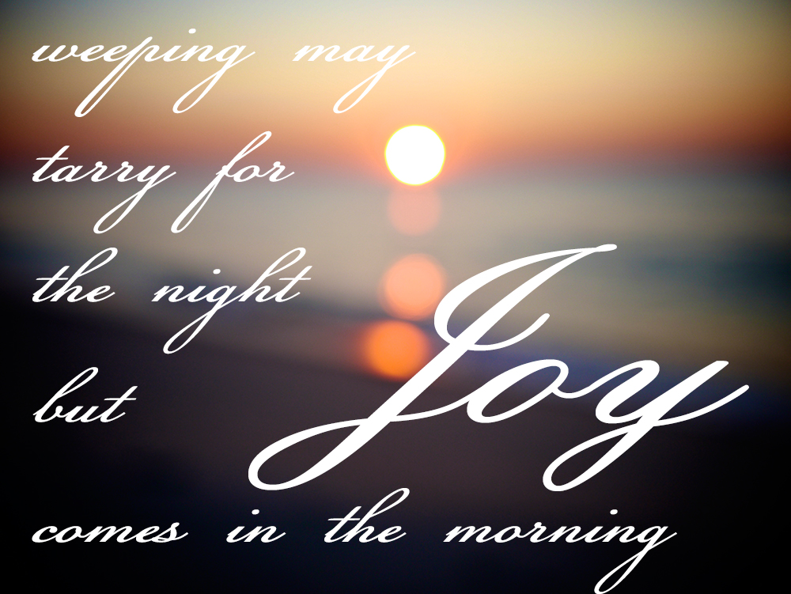
We can find joy and take comfort in knowing that deceased believers go to heaven.
7

Slide 8
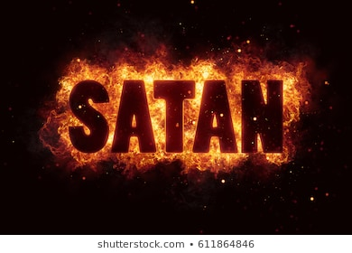
No power, no person, no act in history is beyond the sovereignty of God.
8

Slide 9
Implications and Actions
When a person becomes a Christian, the Holy Spirit comes to live within that believer.
Jesus promised that the Holy Spirit would stay with Christians forever.
He will guide them into all truth—as long as they are willing to listen.
Too many times, believers are too busy leading noisy lives to be able to hear the still, small voice of God.
The Holy Spirit will comfort, guide, direct, and encourage those who take the time to stop and pay attention.
9

Slide 10
Week 11
It is Finished
10

Slide 11
1 Then Pilate took Jesus and had him flogged. 2 The soldiers twisted together a crown of thorns and put it on his head. They clothed him in a purple robe 3 and went up to him again and again, saying, “Hail, king of the Jews!” And they slapped him in the face. (John 19:1–3)
11

Slide 12
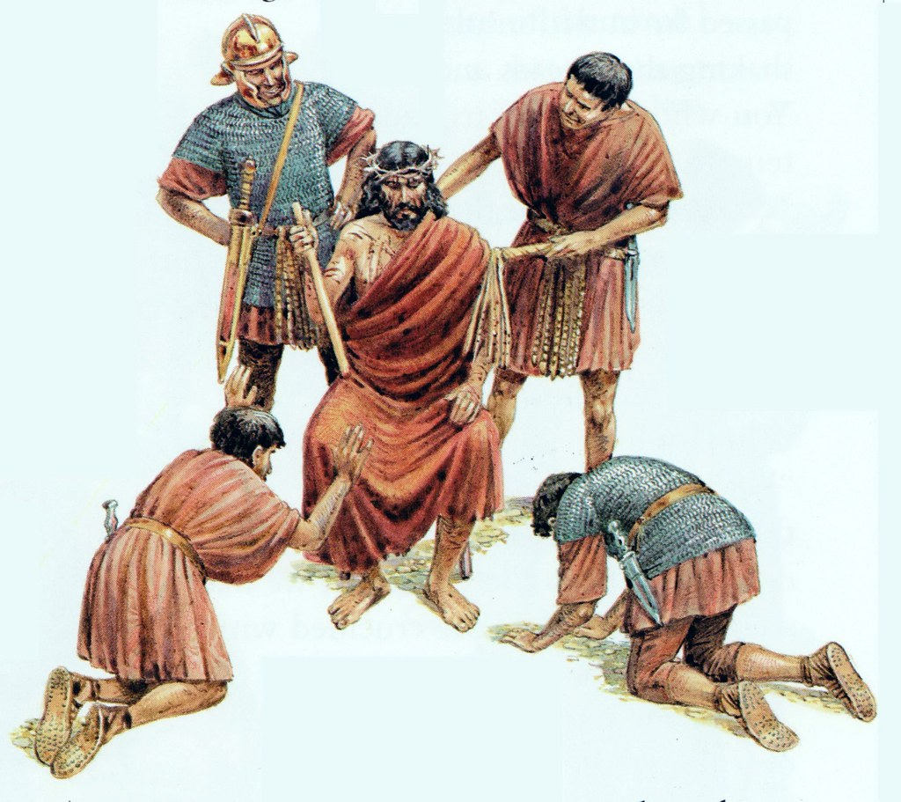
12

Slide 13
Jesus is Flogged, Beaten and Mocked
Pilate could find no crime committed by Jesus.
He commanded his soldiers to flog Jesus, hoping it would be enough to satisfy the Jews, then he could release Him.
Pilate gave his soldiers free reign to do anything they wanted to Jesus, but they could not kill Him.
They beat Jesus, placed a robe and a crown of thorns on Him, and mocked Him as a powerless king.
Pilate made several failed attempts to satisfy the Jews which only resulted in an even louder cry from the crowd, “Crucify Him!”
13

Slide 14
7 The Jewish leaders insisted, “We have a law, and according to that law he must die, because he claimed to be the Son of God.” 8 When Pilate heard this, he was even more afraid, 9 and he went back inside the palace. “Where do you come from?” he asked Jesus, but Jesus gave him no answer. 10 “Do you refuse to speak to me?” Pilate said. “Don’t you realize I have power either to free you or to crucify you?” 11 Jesus answered, “You would have no power over me if it were not given to you from above. Therefore the one who handed me over to you is guilty of a greater sin.” (John 19:7–11)
14

Slide 15
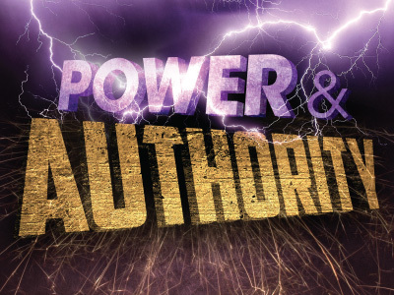
15

Slide 16
Power and Authority
Pilate experienced fear mixed with anger and attempted to intimidate Jesus with his power and authority.
However, if Pilate had the authority he claimed, he would have released Jesus.
Jesus reminded Pilate that God had given him his power, and God would control everything that would happen, not Pilate.
16

Slide 17
12 From then on, Pilate tried to set Jesus free, but the Jewish leaders kept shouting, “If you let this man go, you are no friend of Caesar. Anyone who claims to be a king opposes Caesar.” 13 When Pilate heard this, he brought Jesus out and sat down on the judge’s seat at a place known as the Stone Pavement (which in Aramaic is Gabbatha). 14 It was the day of Preparation of the Passover; it was about noon. “Here is your king,” Pilate said to the Jews. 15 But they shouted, “Take him away! Take him away! Crucify him!” “Shall I crucify your king?” Pilate asked. “We have no king but Caesar,” the chief priests answered. 16 Finally Pilate handed him over to them to be crucified. So the soldiers took charge of Jesus. (John 19:12–16)
17

Slide 18
18

Slide 19
Self Interest
The Jews called Pilate a traitor against Caesar.
Afraid of losing his position (or even worse), Pilate gave into the demands of the Jews and called for the crucifixion of Jesus.
When Pilate washed his hands in front of the crowd as a sign of his innocence, he wanted to make clear that the blood of Jesus would be on the hands of the Jews, not his own.
Although Pilate washed his hands, the ritual did not cleanse his heart.
19

Slide 20
17 Carrying his own cross, he went out to the place of the Skull (which in Aramaic is called Golgotha). 18 There they crucified him, and with him two others—one on each side and Jesus in the middle. 19 Pilate had a notice prepared and fastened to the cross. It read: jesus of nazareth, the king of the jews. 20 Many of the Jews read this sign, for the place where Jesus was crucified was near the city, and the sign was written in Aramaic, Latin and Greek. 21 The chief priests of the Jews protested to Pilate, “Do not write ‘The King of the Jews,’ but that this man claimed to be king of the Jews.” 22 Pilate answered, “What I have written, I have written.” (John 19:17–22)
20

Slide 21
21

Slide 22
The King of the Jews
The title King of the Jews had both messianic and political implications.
Kings in Israel were anointed with oil as a sign of God’s choosing, and the meaning of Messiah is “Anointed One.”
As the Son of David, the Messiah would fulfill the Davidic Covenant and rule on the throne in Jerusalem.
God’s people had been expecting a deliverer since God first promised one in Genesis 3:15.
Jesus was from the royal line of David and could rightly take the title King of the Jews, but because Jesus was not what they wanted, “his own people did not receive him”.
22

Slide 23
25 Near the cross of Jesus stood his mother, his mother’s sister, Mary the wife of Clopas, and Mary Magdalene. 26 When Jesus saw his mother there, and the disciple whom he loved standing nearby, he said to her, “Woman, here is your son,” 27 and to the disciple, “Here is your mother.” From that time on, this disciple took her into his home. (John 19:25–27)
23

Slide 24
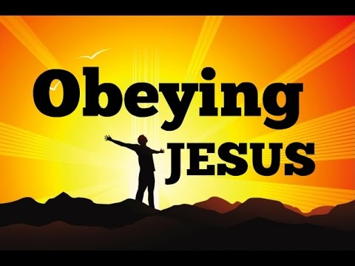
24

Slide 25
Obeying Jesus
In a tender moment, and with great compassion, Jesus arranged for the care of His mother.
He looked to John, a disciple Jesus knew loved Him, and asked him to take care of Mary.
John willingly and graciously took Mary to live with him.
He invited her into his home and family.
John demonstrated what an honor it is to grant a request from Jesus.
He did not complain, ask questions, or hesitate. Instead, he cheerfully accepted Mary.
25

Slide 26
28 Later, knowing that everything had now been finished, and so that Scripture would be fulfilled, Jesus said, “I am thirsty.” 29 A jar of wine vinegar was there, so they soaked a sponge in it, put the sponge on a stalk of the hyssop plant, and lifted it to Jesus’ lips. 30 When he had received the drink, Jesus said, “It is finished.” With that, he bowed his head and gave up his spirit. (John 19:25–30)
26

Slide 27
27

Slide 28
The Work Has Been Done
Jesus’ death,
finished His suffering,
ended the need for the veil that separated the people from the Holy of Holies in the temple (the place of God’s presence),
satisfied the Mosaic Law,
fulfilled redemption’s plan, and
overcame the power of Satan.
Jesus’ human life was over and salvation was complete.
All Jesus had come to do was accomplished.
His words were not words of defeat, but victory!
28

Slide 29
Implications and Actions
The word redemption means “to gain or regain possession of something in exchange for payment or clearing a debt.”
We were all born sinful, and our sin separates us from God and His love.
We are powerless to pay the debt of sin we owe to God.
The Father sent his Son Jesus to pay our sin debt.
To be right with God we must believe and accept that Jesus paid our price, and by this God gains possession of us.
There is nothing left to do; there is nothing we can add.
Because of Jesus, we can belong to God.
29

Slide 30
Week 12
I Have Seen the Lord
31

Slide 31
Verses
15 I will put enmity between you and the woman, and between your offspring and her offspring; he shall bruise your head, and you shall bruise his heel.” (Genesis 3:15)
31

